Slide 1
CTE
New Member
Self-Introduction
MXA DS TEAM
DATA SCIENCE INTERN ENGINEER
HAOCHEN YANG

Slide 2
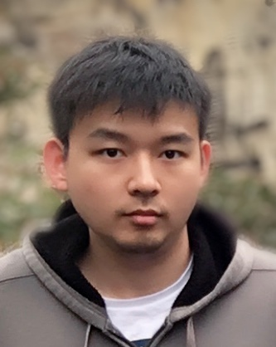
Who AM I ?
What I do ?
What is my hobby ?
What do you know about Micron ?
Or
Anything you want Team member to know

Slide 3
Who am I
HAOCHEN YANG
Born in XI’AN
New Data Science Intern Engineer in MXA
SOMETHING ABOUT MYSELF
Studying in The University of Sydney
Major in Electronic Engineering and Computer Science
Deep Learning, Image Classification
Research on Human Action Recognition with Domain Adaptation
2020 MASTER’S DEGREE (EXPECTED)
Graduated from The University of Melbourne
Major in Electric System
Embedded System
FPGA development
2017 BACHELOR’S DEGREE

Slide 4
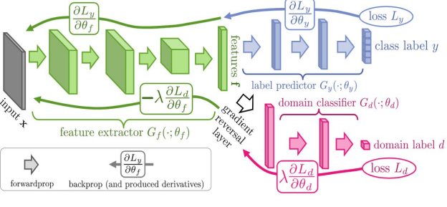
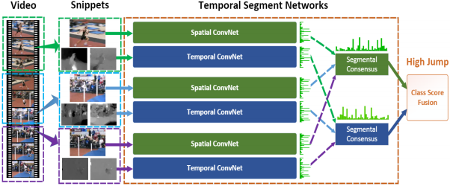
What I do?
Two limitations of video-based human action recognition:
Testing and training data must come from the same statistical distribution
Need signification amount of labelled data to model for each task
How to solve:
Apply domain adaptation technique (eg. DANN – Domain Adversarial Neural Network) into the normal video recognition system (eg. TSN – Temporal Segment Network)
Domain adaptation
with video action recognition
DANN: A kind of domain adaptation network
TSN: one of the most popular network for action recognition

Slide 5



What is my hobby
Basketball
Music
Cooking

Slide 6

What do you know about Micron
How do I know Micron?
Why do I choose Micron?
When I become a DS engineer, I want to do…

Slide 7
THANK YOU!

